Slide 1
作者：王春玲（女）王建智（男）
单位：宁夏中卫市第一中学 宁夏中卫市第五中学
通讯地址：
宁夏中卫市第一中学 宁夏中卫市第五中学
联系电话：18009565871 13739554477
电子邮件地址：632366037@qq.com
wclqxwc@163.com
wjzqxwc@163.com

Slide 2
Finish the following exercises:
is
The boy _____ diving.
are
They _____ diving.
are
Both Jack and Tim _____ diving.
is
Neither Jack nor Tim _____ walking.
are
All of them _____ diving.

Slide 3
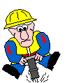
is
Bob _____ a worker.
are
Mike and Bob _____ workers.
are
Both Mike and Bob _______
workers.
Bob
is
Neither Mike nor Bob _______
a teacher.
knows/know
Mike
Neither of them _______
(know) how to teach English.
All of them ______ workers.
are
knows/know
None of them ___________
(know) how to teach English.
Bill

Slide 4
主谓一致
Subject-Verb Agreement

Slide 5
主谓一致的定义
英语句子中，主语的“人称”和“数”要限制、决定谓语动词的形式变化，这就叫“主谓一致”关系。它通常依据三项原则： 1）语法一致 2）意义一致；
3）就近一致

Slide 6
语法一致
1. and连接两个或两个以上单数名词或者代词作主语的时候,谓语动词有以下两种情况：
(1) 如果指两个或两个以上不同的人或 事物的时候,谓语动词用复数。如：
He and I ___both students of this school.
are

Slide 7
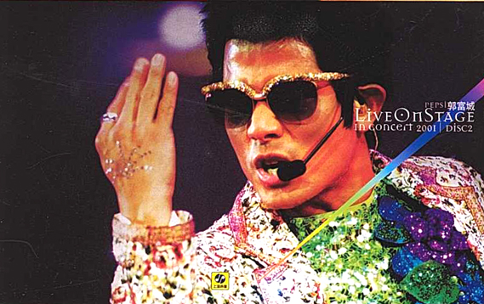
(2) 如果连接两个以上的名词指的是同一个人或物, 或者指同一概念的时候, 谓语要用单数。
a singer and dancer
The singer and dancer _____ on the stage.
is

Slide 8
a knife and fork
The gift is used to have western meals.
What is it?
A knife and fork is used to have meals.

Slide 9
2. 如果主语是不定式，动词ing形式或主语从句的时候,谓语动词用单数。
眼见为实。
To see is to believe. Seeing is believing.
他正在做的事情看起来很重要。
What he is doing seems very important.
收集邮票是他的爱好。
Collecting stamps is his hobby.

Slide 10
3、当主语后面跟有as well as, as much as, no less than,
along with,with ,like, rather than, together with , but ,
except, besides, ,including等引导的词组时，其谓语动词的
单、复数由主语的单、复数而定。
was
1. The teacher with two students ______ at the meeting . (was / were)
A
2.E-mail, as well as the telephones, ________ an
important part in daily communication.
A. is playing B. have played C. are playing D. play

Slide 11
A library with five thousand books ___ to the nation as a gift. A. is offered B. has offered C. are offered D. have offered
Nobody but Jane ___ the secret.
A. know B. knows
C. have known D. is known

Slide 12
4. 用 连接的并列主语被each, every, no或 many a 修饰时，谓语动词 用单数。
Every desk and every chair is made of wood.
Many a boy and (many a ) girl has made the same mistake.

Slide 13
实战一练

Slide 14
5．Nobody but Betty and Mary ____ late for class yesterday．
A．was B．were
C．has been D．have been
6．A woman with some children ____ soon．
A．is coming B．are coming
C．has come D．have come

Slide 15
7．No one except my parents ____ anything about this.
A．know B．knows
C．is known D．are known
8．The teacher as well as the students ____ the book already．
A．has read B．have read
C．are reading D．is reading
9．All but one ____ in the accident．
A．was killed B．were killed
C．will be killed D．are killed

Slide 21
概念一致原则
所谓概念一致原则是指谓语动词和主语一致不是取决于主语的语法形式, 而是其实际意义。有的主语名词在形式上是单数, 但在意义上却是复数；有的主语名词在形式上是复数, 但在意义上却是单数。
1. 不定代词all, more, some, any, none作主语,谓语动词视情况而定。
Most of the apples are rotten.
Most of the apple was eaten by a rat.

Slide 22
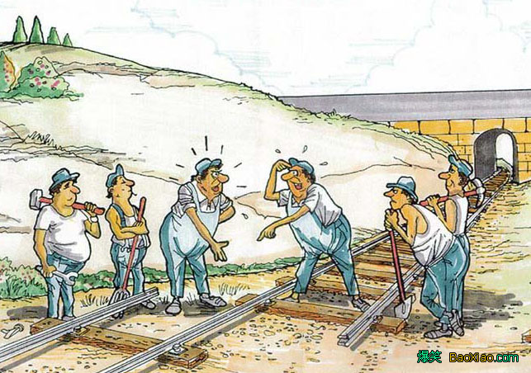
主谓一致
2. 百分数(或分数) + of + 可数名词单数(或不可数名词), 谓语动词用单数; 百分数(或分数)+of+复数名词, 谓语动词用复数. 如:

Slide 23
3. 集合名词作主语, 动词可用单数, 也可以用复数。主要由句子的意思决定。强调整体谓语动词用单数；指全体人员时, 动词则用复数。这一类常见的集合名词有public, family, class, crowd, population, team, group。
is
The group ____ made up of three students.
are
The group____ dancing happily.

Slide 24
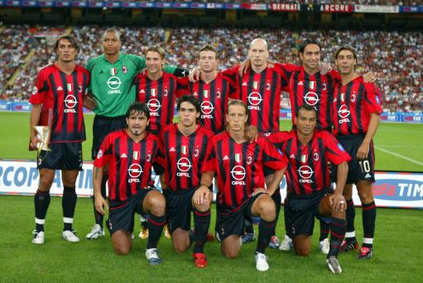
The team ____ some good players. (have)
The team ____ handsome. (be)
has
are

Slide 25
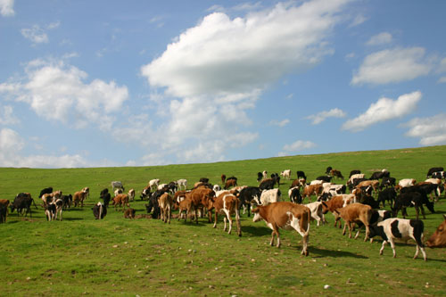
4. 某些名词如people, police, cattle等,形式上是单数, 但意义上是复数, 谓语动词应用复数。
The police are searching for a thief.
The cattle are eating grass on the hill.

Slide 26
5. 复合不定代词作主语, 谓语动词要用单数，如someone ,somebody, something, anybody, anyone, anything, everybody, everyone, everything, nobody, no one, nothing。
Someone is asking for you.
有人找你。
Nothing is found in the room.
在屋子里什么也没找到。

Slide 27
主谓一致
6. 名词如: trousers, scissors, clothes, goods, glasses 等作主语时, 谓语动词必须用复数. 如:

Slide 28
主谓一致
7. 形复意单名词如: news; 以ics结尾的学科名称如: physics, mathematics; 国名如: the United States; 报纸名如: the New Times; 书名如: Arabian Nights; 以及 the United Nations 等作主语; 谓语动词要用单数. 如:

Slide 29
8. 如果主语由“the + 形容词(或过去分词)”结构担任时,谓语通常用复数;这类词有: the brave, the poor, the rich, the blind, the young, the old, the sick, the dead, the deaf and dumb等

Slide 30
主谓一致
就近一致
1. 由here, there, where引导的倒装句中,(有时主语不止一个时), 谓语动词与靠近它的主语在数上一致.

Slide 31
就近一致
2. 用连词 or, either…or, neither…nor, not only…but also 等连接的并列主语, 谓语动词与靠近它的主语在数上一致. 如:
Neither you nor I _____ wrong.
There ____a cup of tea and some apples on the table.
am
is

Slide 32
Exercises:
1．One or two days ____ enough to see the city．
A．is B．are
C．am D．be
2．Neither my wife nor I myself ____ able to persuade my daughter to change her mind．
A．is B．are
C．am D．be

Slide 33
3．Not only I but also Jane and Mary ____ tired of having one examination after another．
A．is B．are
C．am D．be
4．Not the teacher，but the students ____ looking forward to seeing the film．
A．is B．are
C．am D．be

Slide 34
5．Nobody but Betty and Mary ____ late for class yesterday．
A．was B．were
C．has been D．have been
6．A woman with some children ____ soon．
A．is coming B．are coming
C．has come D．have come

Slide 35
7．No one except my parents ____ anything about this.
A．know B．knows
C．is known D．are known
8．The teacher as well as the students ____ the book already．
A．has read B．have read
C．are reading D．is reading
9．All but one ____ in the accident．
A．was killed B．were killed
C．will be killed D．are killed

Slide 36
10. The number of people invited ___fifty, but a number of them ___ absent for different reasons.
A. were; was B. was; was
C. was; were D. were; were
11. ____ of the land in that district ____ covered with trees and grass.
A. Two fifth; is B. Two fifth; are
C. Two fifths; is D. Two fifths; are

